Slide 1

R for Bioinformatics Introduction
Maria-Theodora Pandi
PhD Candidate, Erasmus MC Rotterdam

Slide 2



about::me
PhD Candidate in Bioinformatics, Department of Pathology, Erasmus Medical Center
MSc in Informatics for Life Sciences, Bioinformatics Discipline, UoP
Pharmacy Bachelor Degree, UoP
@mtpandi17
@mtpandi
(Pharmaco)genomics, Bioinformatics, Machine Learning, Health Economics, Text Mining, Biostatistics, Visualization
R / Python

Slide 3
Part 1
Introduction

Slide 4
Table of contents
Bioinformatics
Pharmacogenomics
PGx Resources
R project
R packages
R ladies global
Useful resources
Getting started
Rstudio
Start working
Create a project
Install and load libraries
Update R and packages
Variables
Special values
Operators
Control structures
Functions
Data input and output
Data types and structures

Slide 5
Bioinformatics
Data Mining
NGS data Analysis
Phylogenetic Analysis
Interaction Networks
Structural Genomics
Medical Image Analysis
Medical Decision Support
Drug Design
Modeling
Biology & Genetics
ML & AI
Informatics
Medicine
Statistics
Visualization
Trial and error approach

Slide 6
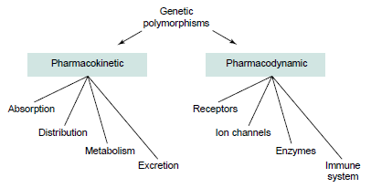
Pharmacogenomics (genome wide) vs Pharmacogenetics (focused areas)
Genome affects response to medications
Adverse Drug Reactions (ADRs)
Effectiveness
Idiosyncratic reactions (immune system- mediated toxicity)
Data driven instead of hypothesis driven
Pirmohamed M, Park BK. Genetic susceptibility to adverse drug reactions. Trends Pharmacol Sci. 2001;22(6):298-305. doi:10.1016/s0165-6147(00)01717-x

Slide 7
PGx Resources
Published literature
Databases: NIH database of Genotypes and Phenotypes (dbGaP), dbSNP, Pharmacogenomics Knowledge Base (PharmGKB), PharmacoDB, DrugBank, PharmVar, PharmacoGenomic Mutation Database (PGMD), Human Genome Mutation Database (HGMD)
Regulatory bodies: Food and Drug Administration (FDA), European Medicines Agency (EMA)
Working Groups: Dutch Pharmacogenetics Working Group (DPWG)
International Consortiums: NIH Pharmacogenetics Research Network (PGRN), Clinical Pharmacogenetics Implementation Consortium (CPIC)
Online tools and applications: PharmCat, Pgenius

Slide 8
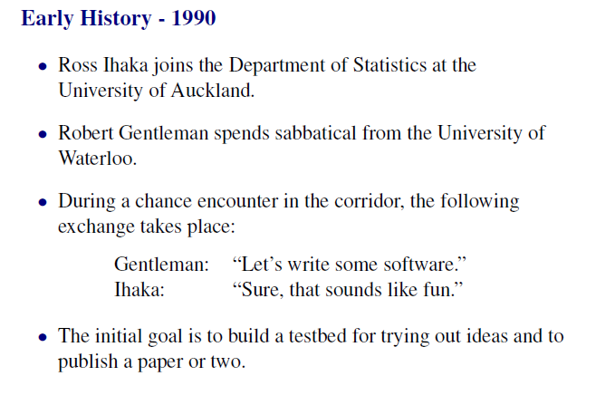
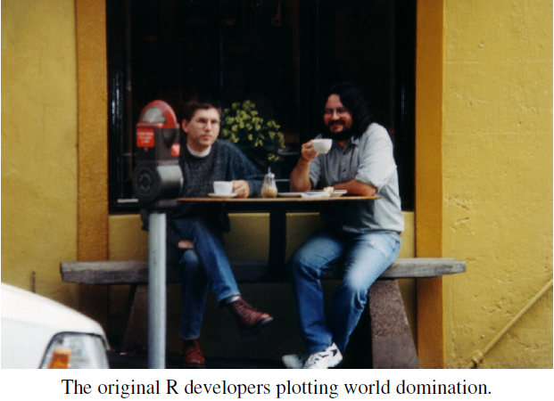

R project
R is a programming language and free software environment for statistical computing and graphics supported by the R Foundation for Statistical Computing
R was created by Ross Ihaka and Robert Gentleman (R&R) at the University of Auckland, New Zealand, and is developed by the R Development Core Team
Based on S (developed at Bell Laboratories by John Chambers and colleagues)
https://www.stat.auckland.ac.nz/~ihaka/downloads/Massey.pdf

Slide 9
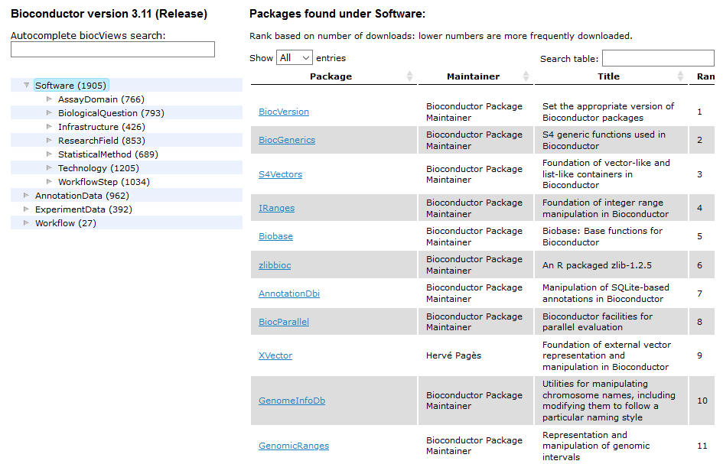

R packages
Base R (pre-installed): base, compiler, datasets, graphics, grDevices, grid, methods, parallel, splines, stats, stats4, tcltk, tools, utils
CRAN (The Comprehensive R Archive Network) distributed packages
Bioconductor packages
GitHub

Slide 10
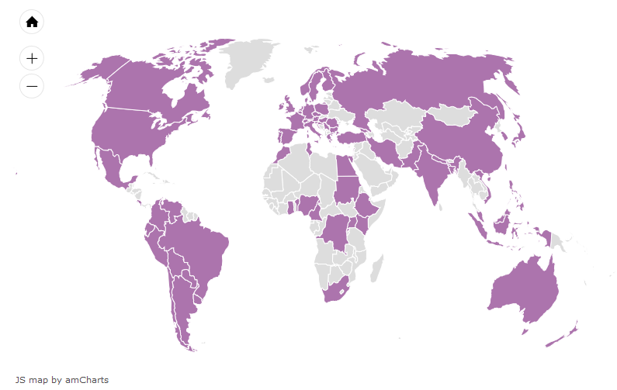

R-ladies Global
A world-wide organization to promote gender diversity in the R community
Founded by Gabriela de Queiroz on October 1, 2012
193 chapters in 54 countries and 71,611 members
R Users
745,965 in 87 countries
https://rladies.org/

Slide 11
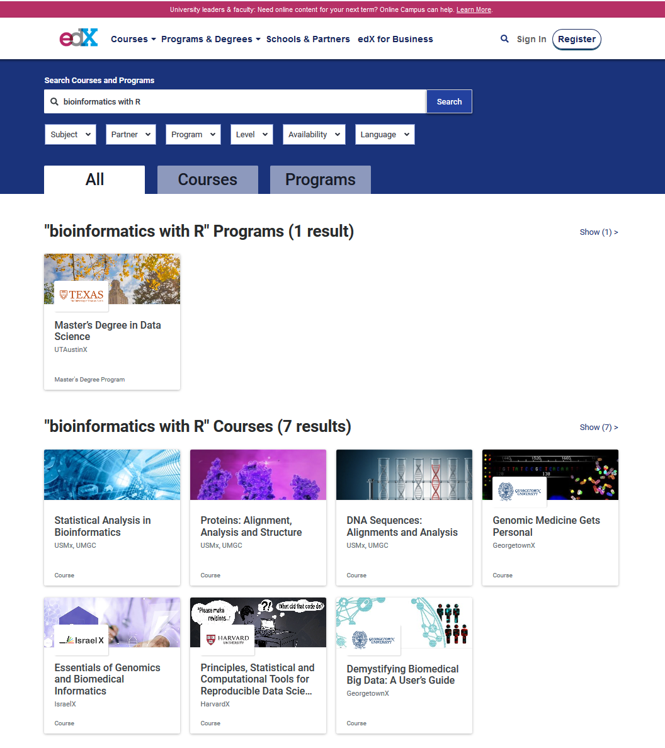
Useful resources
Coursera
edX
Other online tutorials
https://bioinformatics.ca
https://bioinformatics.uconn.edu
https://datacarpentry.org
https://www.r-bloggers.com
https://rafalab.github.io/dsbook/
https://www.bioconductor.org
https://www.costalab.org/bioinformatics-in-r-2019
https://ghr.nlm.nih.gov/primer/genomicresearch/pharmacogenomics
https://www.burns-stat.com/documents/tutorials/impatient-r/

Slide 12


Getting started
Download and install R from https://cran.r-project.org/mirrors.html (choose the mirror for Greece – University of Crete)
No one uses R’s GUI directly, so….
Download and install Rstudio from https://rstudio.com/products/rstudio/
Open Rstudio

Slide 13
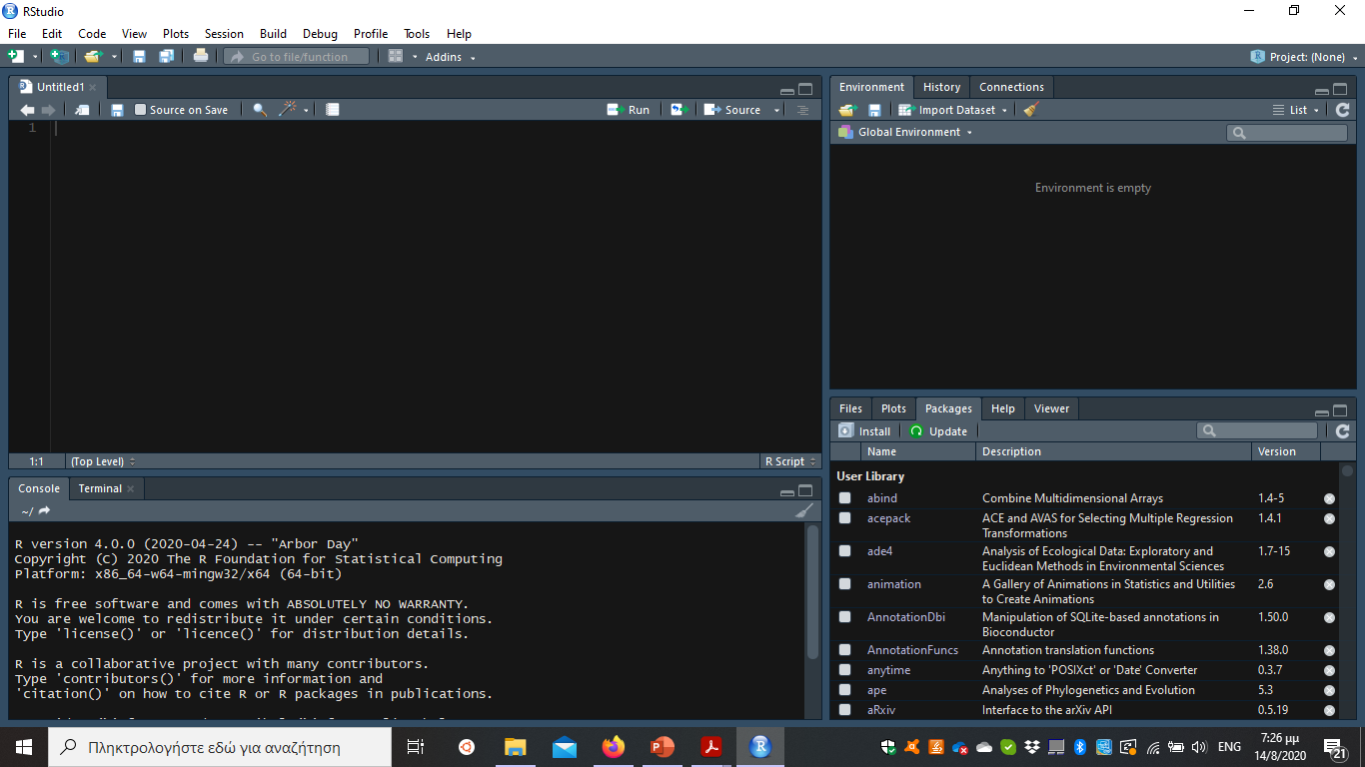
R studio (an integrated development environment (IDE) for R)
Code editor
Environment Variables
History
Info
Files
Packages
Graphs
Console

Slide 14
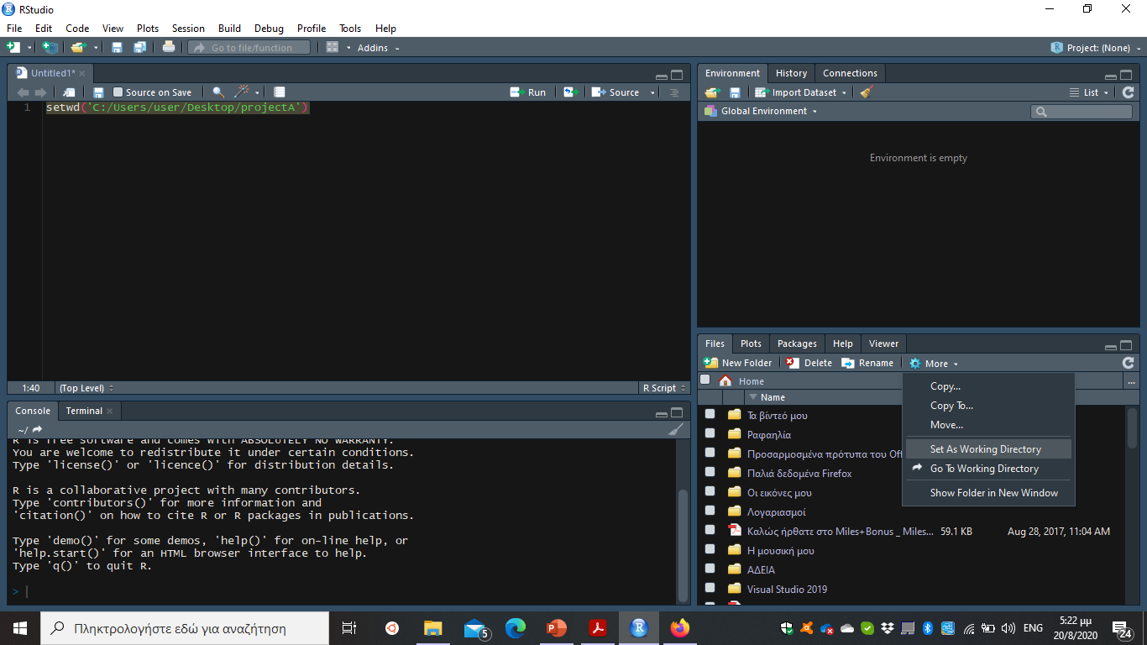
Start working
Always keep your work organized by setting a working directory
How?
Use the setwd() function: e.g. setwd('C:/Users/user/Desktop/projectA’)
Careful there! Paths in windows usually look like this C:\Users\user\Desktop\projectA, so remember to fix the slash (from backward to forward)
From R studio:
Create a project

Slide 15
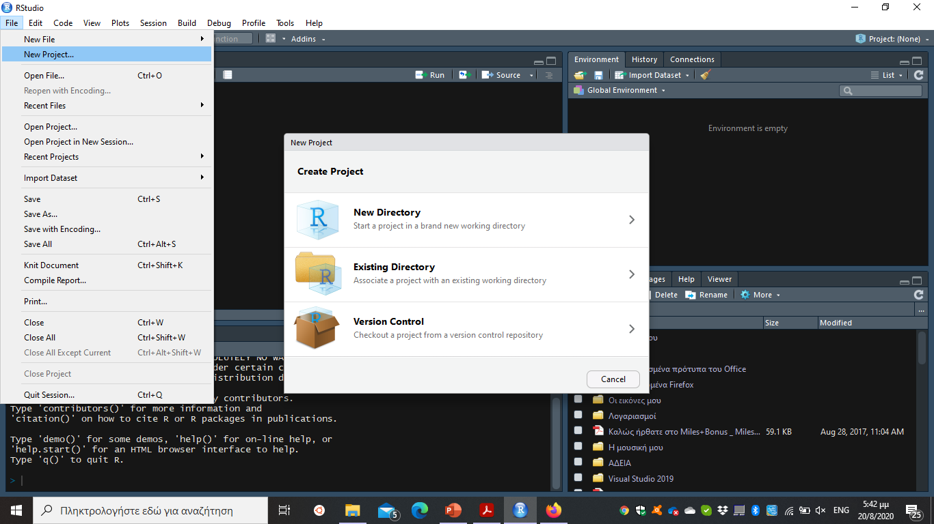
Creating a project
Rstudio: file -> New Project
New Directory -> New Project & set the name of the folder you want to create and the path leading to the location of that folder -> Create Project
Existing Directory -> find the file you want to use -> Create Project

Slide 16
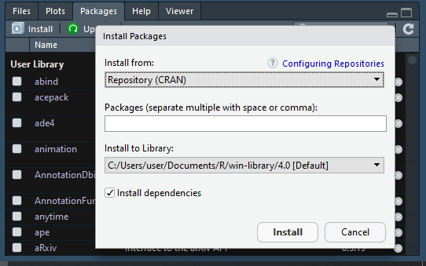
Installing and Loading Libraries
Installation:
CRAN packages: install.packages(“PackageName“)
Bioconductor packages:
if (!requireNamespace("BiocManager", quietly = TRUE)){ install.packages("BiocManager")}
BiocManager::install(“PackageName”)
Github hosted packages: devtools::install_github("DeveloperName/PackageName")
Manually: Rstudio -> Packages -> Install Packages
Loading:
library(PackageName)
PackageName ::Function

Slide 17
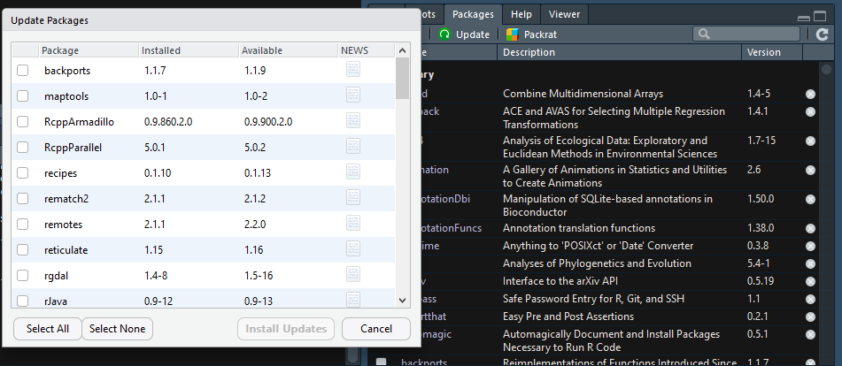
Updating R and packages
Install the library installr and use the function updateR(), as described here: https://www.r-statistics.com/2013/03/updating-r-from-r-on-windows-using-the-installr-package/
Ideally you should move the packages from the old (current) version of R to the next and then remove them (from the old)
You can also create a file containing all the packages you have installed in your current version and use it to re-install or update them
From time to time remember to check for any updates in your installed packages (Rstudio bottom right panel)

Slide 18

Getting help in R
help() function and ? help operator in R provide access to the documentation pages for R functions, data sets, and other objects, both for packages in the standard R distribution and for contributed packages
Usage:
Info for a function from a library you have already loaded: help(functionname ) or help (“functionname”), or ?functionname or ? “functionname” (i.e., the quotes are optional)
Info for a function from a library you haven’t loaded: help(functionname, package = “packagename”)
Info for a package: help(package=“packagename”)
Package vignettes
Stack Overflow
https://www.r-project.org/help.html

Slide 19
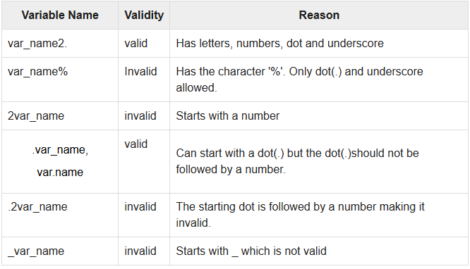
Variables
Create new variables using the arrow operator (-> or <-)
Variable <- 5
5 -> variable
R is case sensitivity
Valid variable names consists of letters, numbers, dot (.) or underline (_)
Valid variable names start from either a letter or from dot (but not followed by a number), e.g.
Other assignment operators:
<<- , ->>, =
https://www.tutorialspoint.com/r/r_variables.htm

Slide 20
Special values in R
# for commented lines
T or TRUE
F or FALSE
NULL = missing values
NA = missing values
NaN = impossible to calculate (0/0, log of a negative number)
Inf = infinity (number/0)

Slide 21
Operators
Category | Operator | Job
Arithmetic | + | Addition
 | - | Subtraction
 | * | Multiplication
 | / | Division
 | ^ or ** | Exponentiation
 | x %% y | modulus (x mod y)
 | x %/% y | integer division
Relational | < | Less than
 | <= | Less than or equal to
 | > | More than
 | >= | More than or equal to
 | == | Equal to
 | != | Not equal to
Logical | ! | Not
 | & && | And (element-wise) And
 | | || | Or (element-wise) Or
Do not forget: counting starts from 1

Slide 22
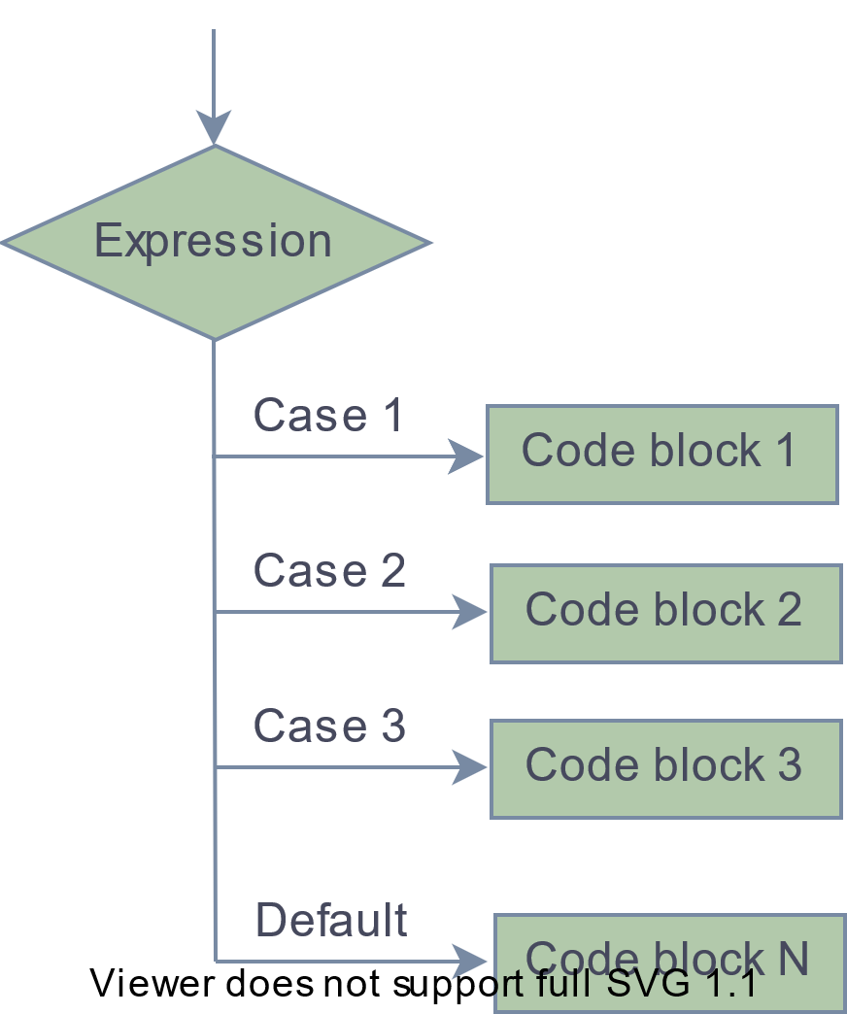
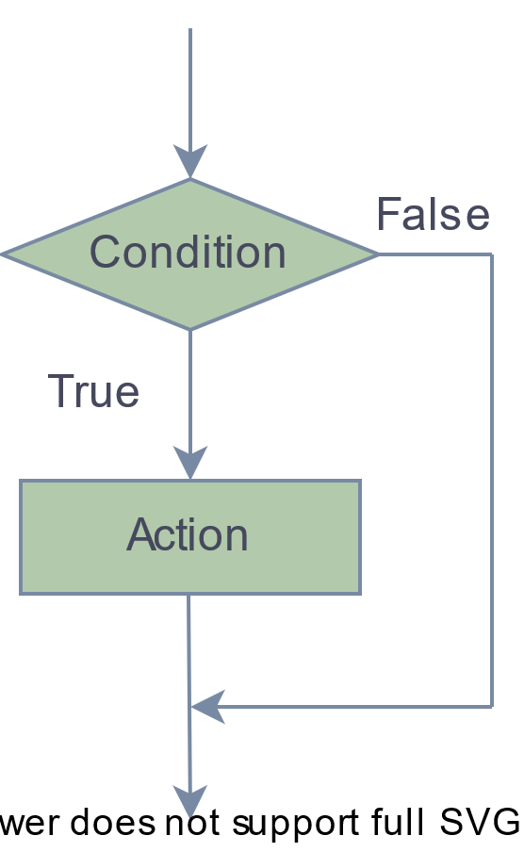
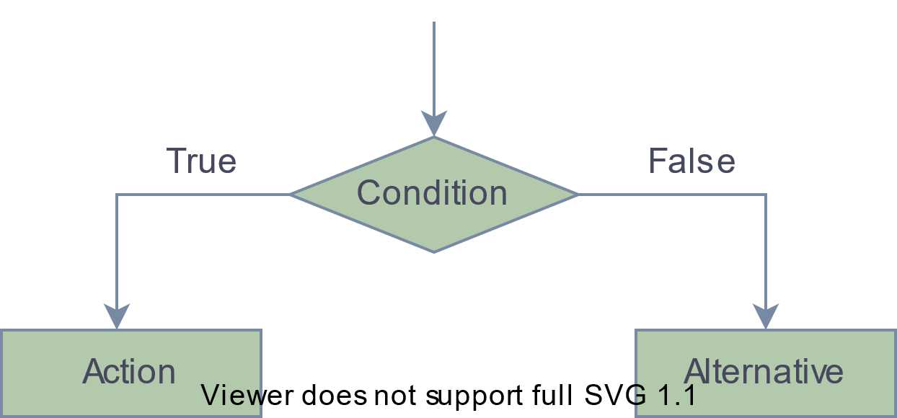
Control Structures - Decision Making
if(Condition){}
if(Condition){}else{}
ifelse(Condition, Action, Alternative)
switch(expression, case1, case2, case3....)

Slide 23
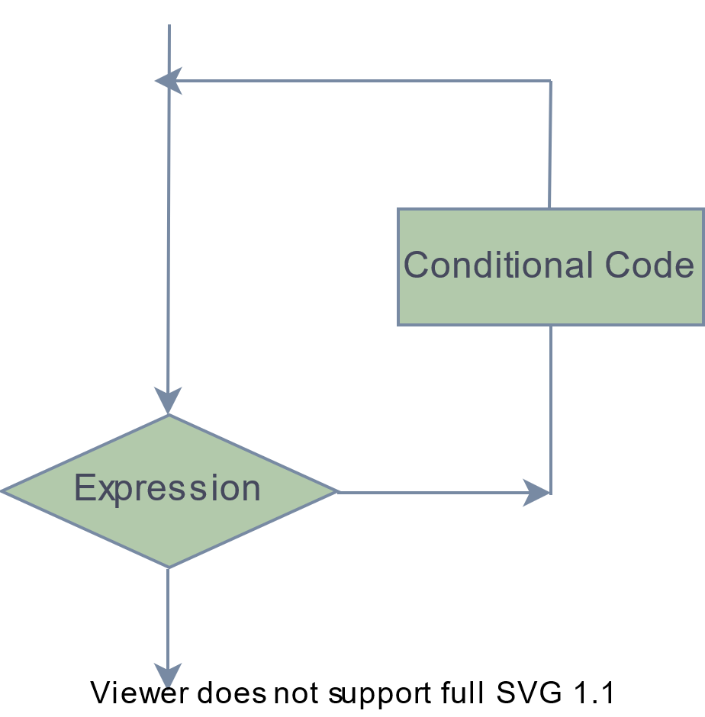
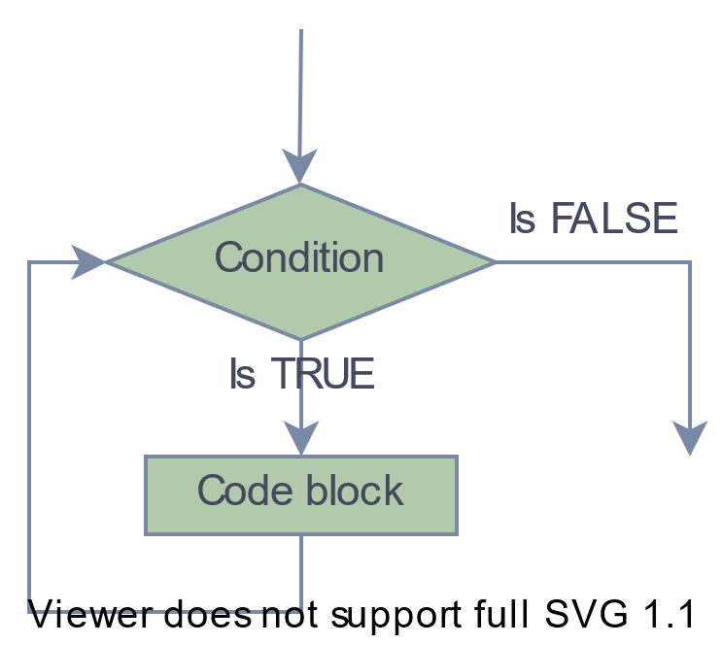
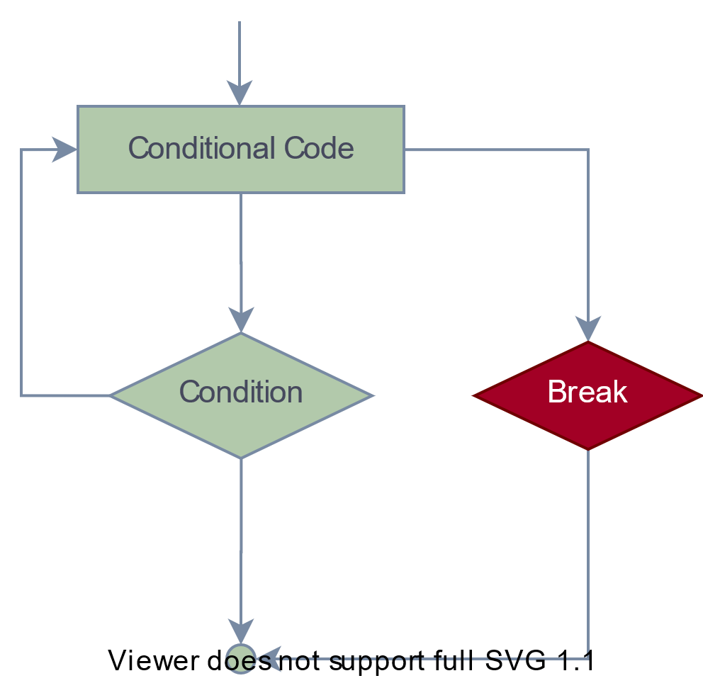
Control Structures - Loops
for (value in vector) {
statements
}
while (test_expression) {
Statement
}
repeat {
commands
if(condition) { break }
}

Slide 24
Functions
Built-in
https://www.statmethods.net/management/functions.html
User-defined
myfunction <- function(arg1, arg2, ... ){
statements
return(object)
}

Slide 25
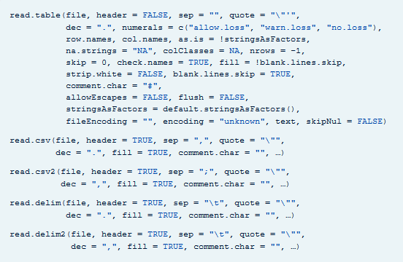
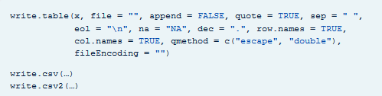
Data input and output
Usually data are imported as tab-separated or comma-separated file formats
Excel files require loading a library (readxl, xlsx) which works the same way
https://www.rdocumentation.org/packages/utils/versions/3.6.2/topics/read.table
https://www.rdocumentation.org/packages/utils/versions/3.6.2/topics/write.table

Slide 26
Data types and structures
Data Structures
Lists
Matrices
Data frames
Data tables
Tibbles
Factors
Arrays
Vectors
Integer
Character
Logical
Complex
Numerical
Data Types
1, 2, 1.5
1L, 2L
“Cat”
TRUE / FLASE
2+2i

Slide 27
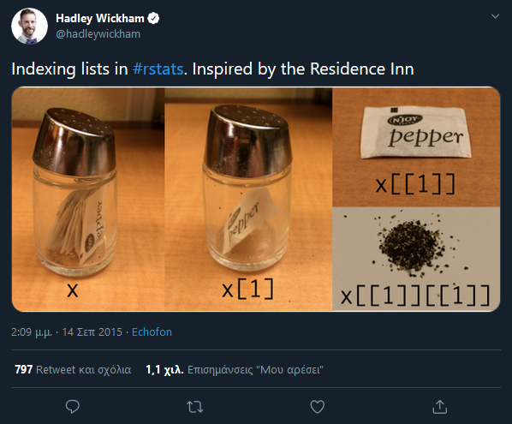
Accessing objects from lists in R
https://twitter.com/hadleywickham/status/643381054758363136

Slide 29
Part 2
Data handling and visualization

Slide 30
Table of contents
Iris Plants Database

Slide 31


Iris Plants Database
Data set created by Fisher (Fisher,R.A. "The use of multiple measurements in taxonomic problems" Annual Eugenics, 7, Part II, 179-188 (1936)) in 1988
perhaps the best-known database to be found in the pattern recognition literature
Contains 3 classes of 50 instances each, where each class refers to a type of iris plant.
sepal length in cm
sepal width in cm
petal length in cm
petal width in cm
class (Iris Setosa, Iris Versicolour, Iris Virginica)
https://archive.ics.uci.edu/ml/datasets/iris

